Slide 1


Effective Public Outreach for Transportation Projects Using Geospatial Analytics
Dr. Okan Pala | opala@ncsu.edu
George Orfanidis | orfanidisg2@winthrop.edu
Notes:
Hello my name is George Orfanidis and throughout this summer I was working on a project with title …

Slide 2
Transportation Planning Process
Choice of site
Ranking transportation needs
Public input
Notes:
As a part of the project development phase, the public outreach and engagement stage is one of the most important parts of transportation project planning. At this stage, the public is informed about the future plans, the benefits for the broader community are explained and direct and indirect feedback is gathered. Organizing and implementing public hearings, while effective, falls short on involving all stakeholder groups who would be affected by the implemented project. One of the reasons for that is the difficulty in identifying and engaging certain transportation project stakeholders.

Slide 3
Problem Statement
Local stakeholders are more likely to get involved in the planning process of it compared to commuting stakeholders
Many stakeholders participate in the planning process to delay the actualization of a project because they simply do not want long term construction near their work or home location.
Local: stakeholders that live or work in close proximity to the project’s location
Commuting: stakeholders that regularly commute near the project’s location
Notes:
Data from previous outreach and engagement campaigns has revealed some public representation flaws. Local stakeholders are more likely to attend public hearings compared to those who are commuting stakeholders. This creates a one-sided perspective that may not reveal the actual value (or lack thereof) of the proposed transportation project.
Additionally, participation data has revealed that many people get involved in the planning process to push back the actualization of a project simply because they do not want constructions near their location. Evidently, it is important to identify stakeholders that have honest interest in the outcome of the project.
The overall purpose and effort of identifying stakeholders and appropriately targeting them is to have an equal, fair, and full representation of people involved with and making decisions for a given transportation project.

Slide 4

How Does One Effectively Identify Transportation Stakeholders To Target Them Using Popular Advertising Platforms?
Notes:
So, the main question that arises is how ...

Slide 5
Approach Overview
Identification of non affected areas
Network Analysis
Automated targeted advertising
Spatial Engagement Portal
Selection of areas with demographic interest
Notes:
The answer to this question is rooted in location and demographic analysis.
Here is an overview of the public outreach and engagement method we developed to efficiently identify and target affected transportation stakeholders
Multiple online advertising campaigns will be created by an automation tool called RPA. Demographic concentration analysis in conjunction with spatial analysis will be used to determine the areas of interest. Finally, targeted stakeholders will be directed to a personalized portal that will inform them about the proposed project. They will also be able to express their opinion by submitting a form.

Slide 6
Network Analysis

Slide 7
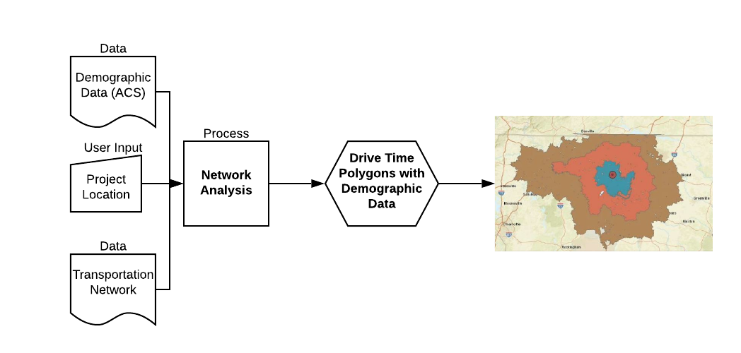
Previous Work
Credit: Xena, Hong (2019)
Notes:
Our tool will use Network analysis and driving polygons with demographic data that has been previously created (Pala, Xena, 2019). We aim to utilize those driving polygons to determine the locations of interest by further spatial and demographic analysis.
Drive-time polygons basically depict how far someone can reach in a specified amount of time if he or she is driving under the speed limits.
The initial phase was to collect relevant data to conduct network analysis. Road data was collected from different categories to form the transportation network. Moreover, demographic data from the American Community Survey (ACS) was incorporated to estimate the population of a specific demographic category within the borders of the driving polygon. Finally, the project’s location was used as the center of the driving polygons (Figure 1).

Slide 8
Identification of not affected areas
Network Analysis

Slide 9
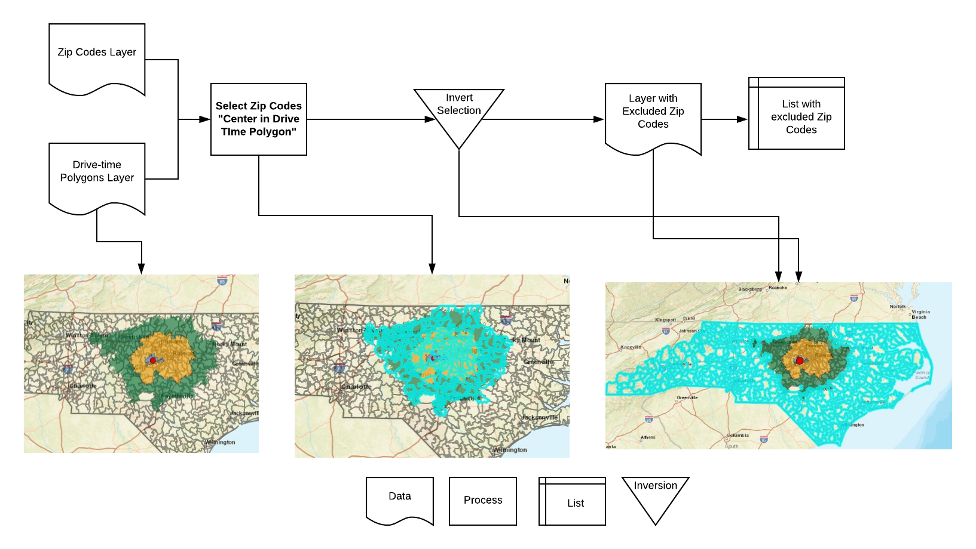
Location Exclusions
Notes:
The drive-time polygons will be used to identify the regions of interest for a specified transportation project. The outer drive-time polygon will determine the last area for targeting. Everything outside of that border will be considered irrelevant for targeting and as a result, will be excluded. We assume that people outside that region won’t be affected since they are far away from the project’s site (more than an hour away).
The most effective way to map the drive-time polygons as accurately as possible is by the use of Zip Codes. Our location script, firstly identifies what Zipcodes have their center in the driving polygon.. Then,the rest of North Carolina Zip Codes that are not within the boundaries of the polygon are marked for exclusion. Because Zip Codes spread out across multiple counties it was not viable to exclude broader geographic groups after we have identified the zip codes that map the drive-time polygons. Finally, all the other states and countries will be excluded to give us the final area of interest.

Slide 10
Identification of non affected areas
Network Analysis
Selection of areas with demographic interest

Slide 11
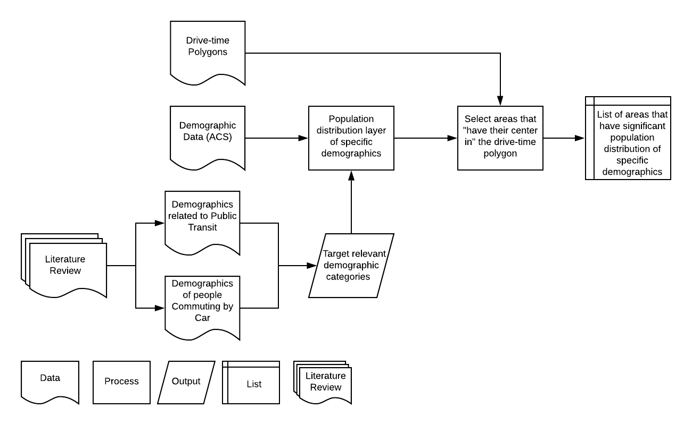
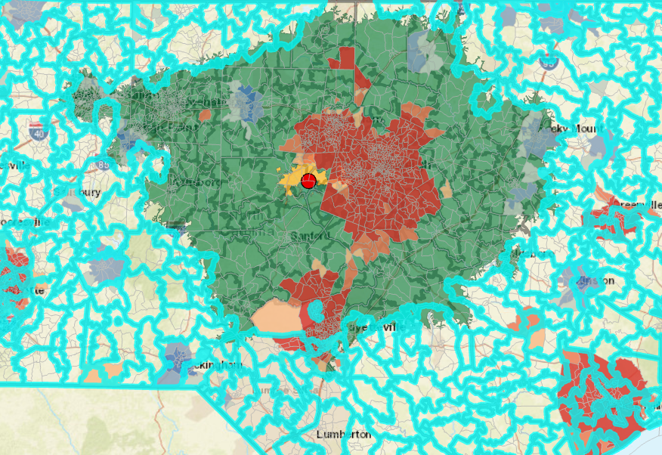
Demographic Targeting
Notes:
With regard to targeting based on demographics, after a thorough literature review we have created demographic profiles based on people who are more relevant or have a greater interest in specific transportation projects. For example, consider people who regularly use public transportation to go to work, their feedback on a new public transportation project may be more applicable.The two categories that have been studied are public transit and commuting by car. The first category can be used to target people that are relevant to a public transportation project while the second category covers transportation projects that mainly affect stakeholders that use automobiles for commuting.
Overlaying the drive-time polygons with specific demographic data from the American Community Survey we constructed a hotspot layer that includes areas that have high concentration of stakeholders with the specific demographic characteristics we have identified and are within the outer drive time border.

Slide 12
Approach Overview
Identification of non affected areas
Network Analysis
Automated targeted advertising
Selection of areas with demographic interest

Slide 13
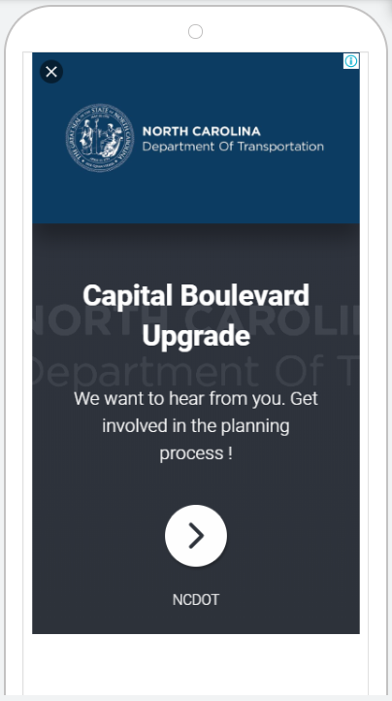

Automated Creation of Campaigns
List with excluded Zip Code, US States and counties
List with areas that have significant population density of specific demographics
Personalized Spatial Engagement Portal
Notes:
It would be very time consuming to individually run the spatial and geographical tools and utilize their results to structure advertising campaigns for several transportation projects. Consequently, Robotic Process Automation will be used to create targeted advertising in the most efficient way. Robotic Process Automation, RPA stands at the process-driven side of the continuum known as Artificial Intelligence. Along with Robotics and Artificial Intelligence technology, scientists and software developers have also constructed programs whose aim is to automate repetitive tasks.
RPA will call up the corresponding spatial and demographic analysis scripts that will run on ArcGIS Pro. The results of the scripts will be saved locally for future use by the RPA. Then, the automated script will locate the csv files with the outcome of the analysis and use them as input in order to set up the location targeting and achieve our advertising goals.

Slide 14
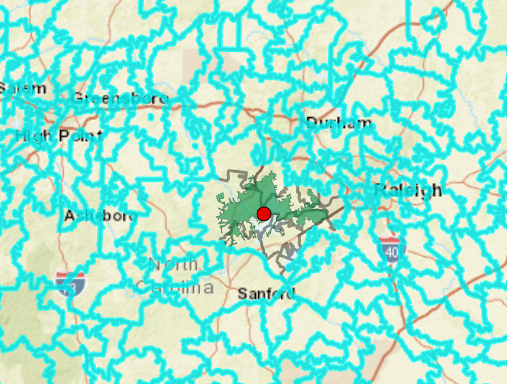

Creating Campaigns
Goal 1: Target local stakeholders
Notes:
Goal 1: Target local stakeholders
We aim to target stakeholders whose house is located in close proximity to the project’s site and as a result, they will be centrally affected by the implementation of the proposed project. The shortest drive-time polygon will be imported in our exclusion method and in relation to the Google Ads targeting option “People in or regularly in your targeted locations” we aim to only target local stakeholders. Additionally, the “ad projection time” option will be utilized to further restrict the pool of stakeholders that are eligible to receive the ad. For instance, since the specified campaign aims to target people that live there, it will be projected between 7 pm and 12 pm, a time period that most companies are closed and consequently employees have returned to their residences.
So, combining our exclusion method with the available targeting option “people in or regularly in” we are sure that only stakeholders that are centrally affected will be targeted

Slide 15
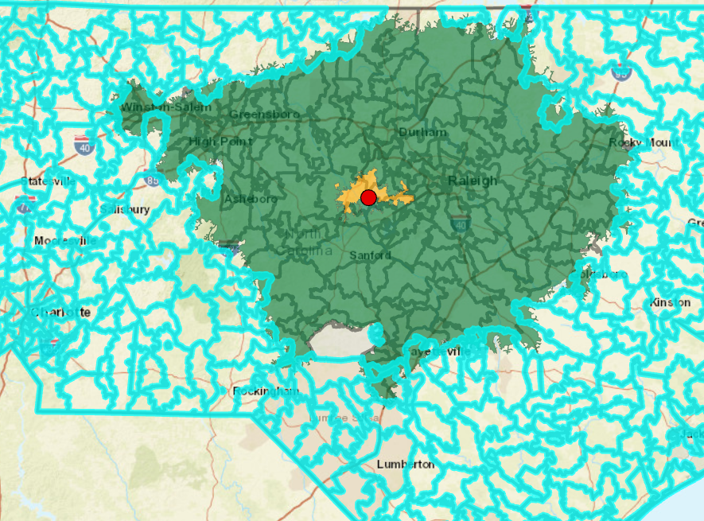
Creating Campaigns
Goal 2: Target nonlocal stakeholders that are related to the project’s location
Notes:
Goal 2: Target nonlocal stakeholders that are related to the transportation project site
We aim to target migratorily affected stakeholders that regularly commute to the projects’ site.
The Google Ads targeting option “People in or regularly in your targeted locations”, as its name says, will send advertisements to people that are often in the center (inside the red circle). Instead of showing ads to people only when they are physically located in the targeted location, it will also be possible to send them to people who regularly commute or travel to the targeted locations even when they aren’t physically there. However, if they are not physically in the red circle, they will still have to be inside the bounds of the drive time polygons. If they are outside the outer green ring they are in the excluded regions and there is no way of them receiving the ad no matter how much they travel to the center.

Slide 16
Creating Campaigns
Goal 3: Target stakeholders that have a greater interest in the proposed transportation project
Notes:
The final goal will be to target stakeholders …
In order to meet this goal both the exclusion and demographic tool will be used
Again the outer drive-time polygon will be imported in the exclusion tool but now demographic analysis will be added to further identify stakeholders that have a greater interest in the proposed transportation project and are either centrally or migratorily affected.
As you can see in the graph the red areas are locations that have high concentrations of stakeholders with the specific demographic characteristics we have identified in our literature review.

Slide 17
Approach Overview
Identification of non affected areas
Network Analysis
Automated targeted advertising
Spatial Engagement Portal
Selection of areas with demographic interest

Slide 18

Spatial Engagement Portal
Notes:
Once the affected and relevant stakeholders have been attracted they will be directed to the personalised Spatial Engagement Portal (SPEP). The SPEP portal will be implemented with ArcGIS Story Maps and Surveys123. Its aim is to provide detailed information and engage the stakeholders with the perceived project outcomes through a user friendly, highly engaging interface [proposal]. Additionally, the attracted stakeholders will be able to provide their feedback on the project and any suggestions that they may have. Finally, they will be asked to complete a quick survey that will help us evaluate our innovative public outreach and engagement approach.

Slide 19
THANK YOU !
ANY QUESTIONS?
Dr. Okan Pala | opala@ncsu.edu
George Orfanidis | orfanidisg2@winthrop.edu

